Slide 1
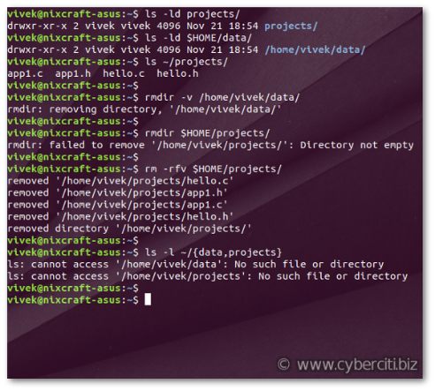
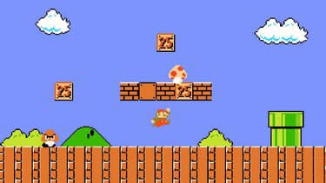
Python libraries
From terminal to gaming

Slide 2
FIND 3 WAY TO SELECT
A RANDOM VALUE IN THIS LIST
colors = ['red', 'blue', 'green']
CHOICE
SHUFFLE
RANDINT

Slide 3
ORGANISATION YOUR CODE BY SECTIONS
IMPORTS
CONSTANTS
GLOBAL VARIABLES
FUNCTIONS
GRAPHICS INITIALIZATION

Slide 4
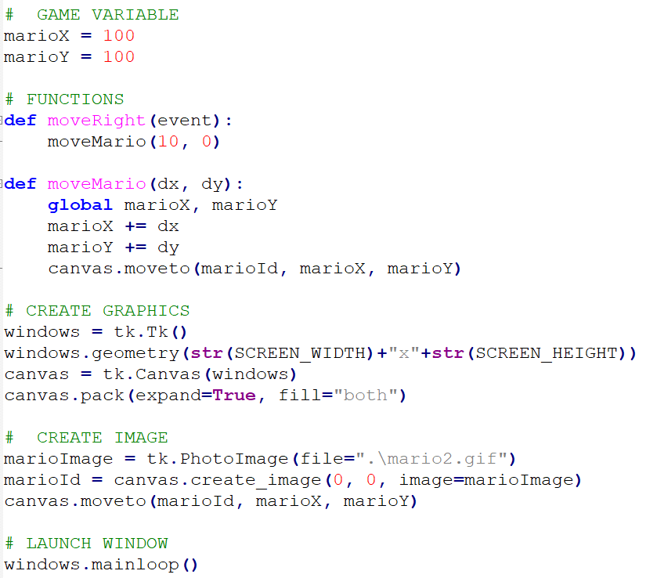

Slide 5
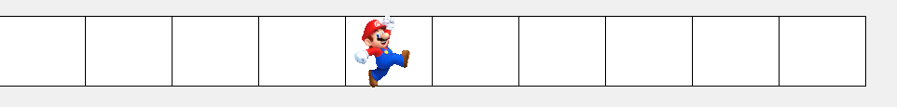
From data structure to graphism
[0,0,0,0,1,0,0,0,0,0]

Slide 6
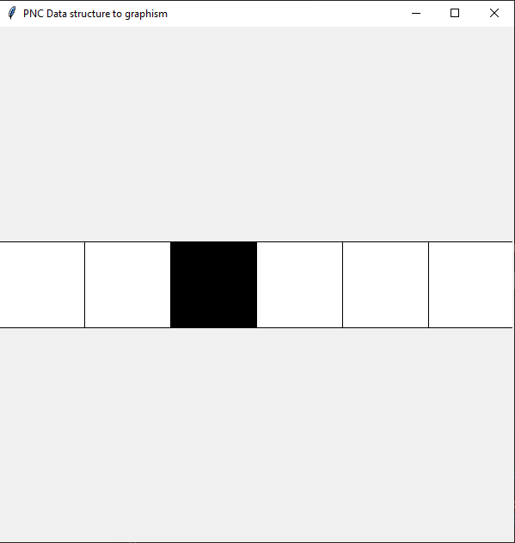
STEP 1
arrayToDrawing()
global grid
Notes:
Send the s8-01-arrayToDrawing-INST.py code to complete
Give tips on using a loop and canvas.create_rectangle
The correction is in s8-01-arrayToDrawing-COR.py

Slide 7
STEP 2
→ Use events to change the index of the 1 in the array, with your keyboard.
[0,0,1,0,0,0,0]
Click on “R”
Instructions:
- The 1 should never get out of the array
- Use an intermediate function that is not bind to an event
[0,0,0,1,0,0,0]
Click on “L”
[0,0,1,0,0,0,0]
Notes:
The goal here is to make them understand they first need to code a function that returns the index of the 1 Tell them the one should not go out of the array by

Slide 8
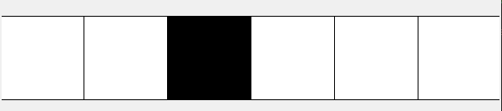
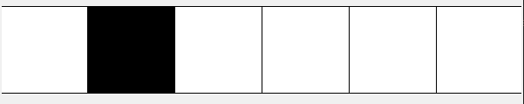
STEP 3
→ Now, make your square move to the right and left on your canvas, by combining the two codes.
Click on “L”
Click on “R”
Notes:
Should be easy now

Slide 9
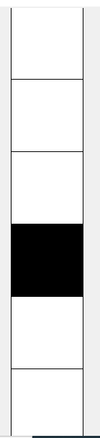
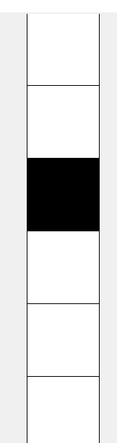
STEP 4
→ Now, do the same exercise but vertically
Notes:
Should be easy now

Slide 10
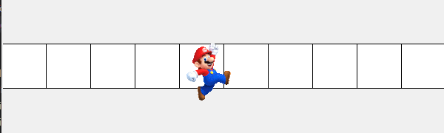
BONUS
→ Move a Mario image instead of a stupid square
Notes:
Bonus but not sure to put it because using images is quite confusing with tkinter

